Slide 1


Work based learning
John Forgan - Kathryn Elliott
j.forgan@kingston.ac.uk
kathryn.elliott@kingston.ac.uk
Notes:
Presentation will be in five sections
INTRODUCTION
EXPLANATION of Masters by LC framework
POTENTIAL CANDIDATES
ORGANIIZATION

Slide 2






Kingston Business School

Slide 3






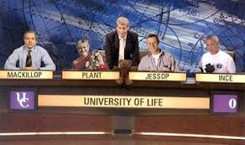

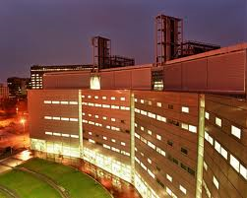


Slide 4

“You can not teach a man anything. You can only help him to discover it within himself”
(Unknown Author)

Slide 5
Work Based Learning Centre within the Faculty of Business and Law
Validation of Post Graduate qualifications by Learning Agreement degrees at Kingston University. 11 Business titles (see next slide).
These qualifications have their own Board of Study and Examination Boards
The flexible nature of the awards means that they are suitable for collaborative partnerships – Merlin Entertainments, European Commission, Action for Children
Notes:
Internally, a set of Masters degrees were validated in March 2002 - MSc Technology, MA Business, MSc Healthcare
This led to a Board of Study separate from any Faculty.
The Postgraduate Credit Framework, along with the field specification + management document is the rulebook for how the courses are operated

Slide 6

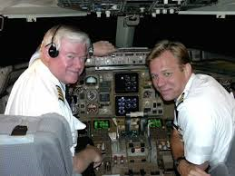




Clinical approach to management education

Slide 7
Masters by LA titles in the Faculty of Business and Law (Masters, PG Diploma, PG Certificate)
Business and Management Practice
Leadership Practice
HRM Practice
Career and Talent Management
Organisational Learning and Development
Project Management Practice
Marketing Practice and Management
Coaching, Supervision and Mentoring (not formally approved)
Consultancy Practice
Innovation and Entrepreneurship
Quality Leadership Practice

Slide 8




“The future of work will consist of learning a living”
(Marshall McLachan)

Slide 9


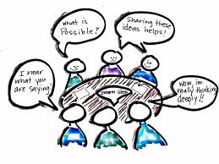


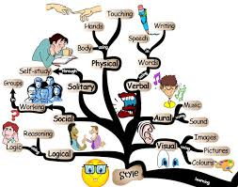



Working is learning

Slide 10
Essential design features
OUTPUT (student) not INPUT LED
DEMAND not SUPPLY (tutor) LED
Notes:
Though there has been a significant change in thinking at the HE level, LEARNING OUTCOMES in module descriptors, there is still a considerable focus on the INPUT to a module.
The M by LC is much more concerned about the OUTPUT and how learning has resulted.
Probably more important is our view that HE provision @ PG level MUST be DEMAND led rather than SUPPLY led. In many cases taught PG awards have been put together and launched into a market that is overcrowded with awards and within which competition is fierce.
We instead have the flexibility to deal with companies, organisations & individual students & produce programmes of real relevance & benefit to both the individual candidate & their organisation.

Slide 11



KEY DESIGN PRINCIPLES
Scholar – Practitioner
2 Way Learning Transfer
Theory into practice
Practice into theory
Satisfy organisational and individual needs simultaneously
Learning Outcomes, Knowledge, Understanding, Skills, Attitudes, Values
Notes:
These programmes are driven more by OUPUTS than INPUTS.
The work-based learning principle recognises that learning takes place in all areas of life - not just in the traditional classroom environment – and enables abilities and knowledge developed in the workplace to be credited with academic recognition

Slide 12
UNDERPINNING KNOWLEDGE AND COMPETENCE DEVELOPMENT PROCESSES
FROM A WBL PERSPECTIVE
Theory
Practice
Theory
Theoretical Conceptualisation
Application
(Theory into practice)
Model Building
(Practice into theory)
Benchmarking
Practice
B.McCormack

Slide 13
The debate:
Two paradigms co-existing:
Learning as acquisition: Formal, subject, curriculum, deepening, knowledge, boundaries, academic, explicit,
mode 1 learning.
Learning as participation: Informal, process, socially constructed by communities of practice, integration, work-based, implicit, tacit, mode 2 learning.

Slide 14
Distance Learning
Mainly Mode 1 because pre-determined in depth subject material is provided from a distance.
E.g. UK’s Open University

Slide 15
Work Based Learning
Learning and producing evidence of learning from activities in the workplace (Mode 2); but in our case some supporting workshops and mandatory pre-workshop reading (Mode 1) is provided.
Post workshops assignments provide evidence of learning for accreditation.

Slide 16
Evidence is crucial for academic work
Critical analysis and evaluation requires you to support your arguments with evidence.
What is good evidence?
References, secondary information, primary information. Quantitative often tells what may be an issue, functionalist (third person). Qualitative-personal reflection (first person), diaries, open questions (content analysis) may tell why it is an issue.

Slide 17
Potential issues arising on assignments:
Lack of sufficient evidence
Lack of adequate reading/theory
Lack of “critical” reflection
Flat unimaginative presentation in reports
Unfocused objectives
Thin Conclusion
Limited recommendations

Slide 18
Learning Agreement
An individually designed programme specifying outcome(s), activities, assessment criteria and mode of assessment for a series of “modules” (Learning goals)
KU will tailor a generic Learning Agreement for the programmes where there is a group
Master classes / workshops will be underpinned by assignments based in the workplace

Slide 19
A Learning Agreement
APEL
Projects
Company
Courses
APCL
TM
Notes:
Each Learning Contract maybe considered a ‘basket’ in which one or more of the following elements may be contained:
Accredited Prior Certificated Learning (APCL)
Accredited Prior Experiential Learning (APEL)
Taught Modules e.g. OU module or stand-alone course
Company Courses
Projects
The exact composition of each basket will vary depending on the student.

Slide 20
Levels and Credits
The LA is in three 60 credit phases, Certificate, Diploma and Masters
Each phase can be split into learning goals of 10, 15 or 20 credits.
APL can help build up credits.
The final Masters stage is a project and is usually split 15 credits for the proposal and 45 credits for the final strategic implementation project

Slide 21
Goal & Credit Value | Learning Outcomes | Activities | Assessment Criteria | Mode of Assessment
C 15M | On completion of Learning Goal C, the candidate will be able to: Understand and be able to apply the main concepts, practices and theories used in pay, working conditions, internal communication and horizontal processes in HR management | Conduct self assessment Read appropriate literature as directed. Attend underpinning taught programmes and complete supporting coursework. Reflect on the four HRM Core processes covered in this learning goal with peer group. Benchmark against selected organisations | The candidate must: Demonstrate knowledge based on the Core HR processes. Show evidence of the application of relevant knowledge to practical situations in your organisation.. Identify and refer to appropriate literature. Demonstrate critical reflection. | A report (3000 words maximum, excluding annexes) which covers an activity delivered in one of the Core HR processes within the delegate’s area of work.
Notes:
This is an example of a detailed learning outcome record. It has many of the features that one would expect in a module descriptor.
I am showing this particular example because it illustrates one of the models Brian has developed. Here we are using a Learning Tree course as an INPUT and building on this to form a M level outcome matched by M level evidence of learning.

Slide 22
Post Graduate Qualifications by Learning Agreement framework
Assessment
  Each “Module” (Learning Goal) is double-marked
  Assessor normally marks first & is “fresh” to programme
  Academic Supervisor marks 2nd
  Mark is subject to External Examiner scrutiny
Notes:
The learning contract has been developed over a number of years.
The modules are based around what the candidate is trying to achieve within the company / organisation setting.
This could be one very large project that is divided into a number of phases
FEASIBILTY
DESIGN
IMPLEMENTATION
TESTING
EVALUATION
Or a number of projects leading to an overall aim for the programme. An example might be improve the screening of compounds for pharmaceutical use.

Slide 23
Masters by LA - supervision:
In general these are SELF-DIRECTED programmes, but can be structured around Executive Development programmes.
Via WBL team in the faculty.
Virtual classroom activities can be provided.
Workshops / Master Classes can be provided on programme elements.
Linking with in-company programmes and workplace mentors.

Slide 24


“The only truly educated person is the one who has learned how to learn”

Slide 25


Thank you. Any Questions?

